Slide 1

SOCIAL NETWORK ANALYSIS
Sentiment analysis of Twitter users towards the Climate crisis based on actions of environmental movements
MARCH 2023
GROUP MEMBERS:
• Samuel Obeng Takyi (881431)
• Jinpeng Zhang (886854)

Slide 2




CONTEXT
Social platfrom analysed:
TWITTER
Countries of interest:
Italy
UK
US
France
Spain
Events: foul acts committed by members of envitonmental movemen gorups

Slide 3
Does committing crimes really have a positive impact on the masses?
Is it really necessary to attract public attention by targeting art?
QUERIES
How can we help our planet for ourselves and future generations?
How was this message perceived by users of the Twitter social platform?

Slide 4
Louvre in Paris
Courtauld Gallery in London
The Kelvingrove Art Gallery in Glasow
The Manchester Art Gallery
the National Gallery of Art in London
ENVIRONMENTAL PROTESTS
Uffizi in Florence
Museo del ‘900 in Milan
Barberini museum in Germany
Mauritshuis’s museum
Padro’s museum in Madrid

Slide 5


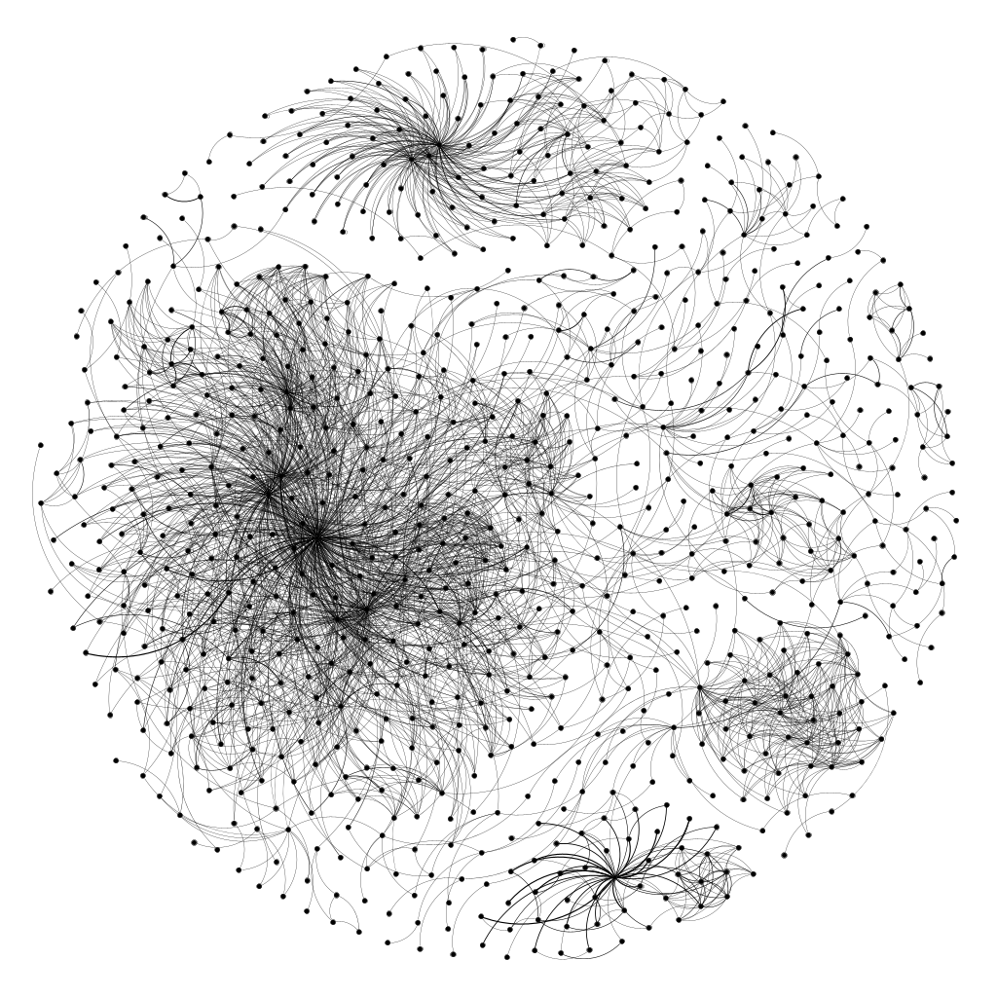
DATA COLLECTION
Analysed events:
- Trends
- Sentiment
- Interactions between users
The data was gathered through the SNScrape library
5.72GB of information

Slide 6
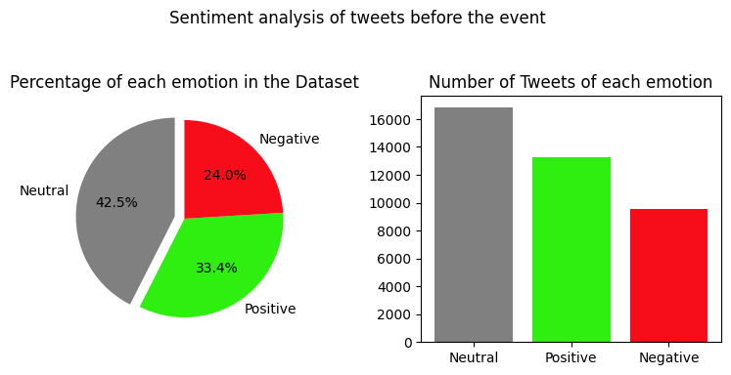
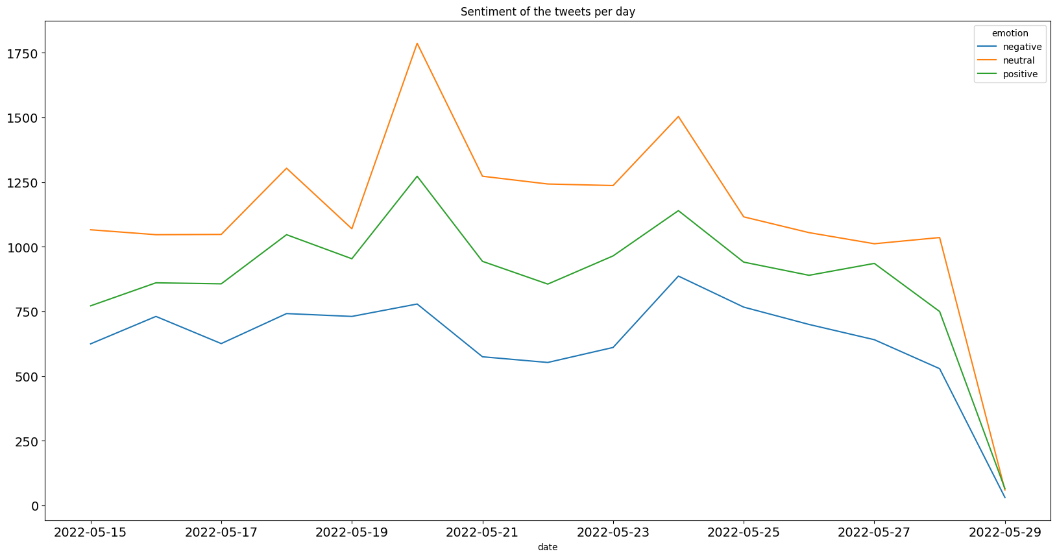
SENTIMENT ANALYSIS
Analyze users' attitudes towards a particular topic using an algorithm that determines their emotions.

Slide 7
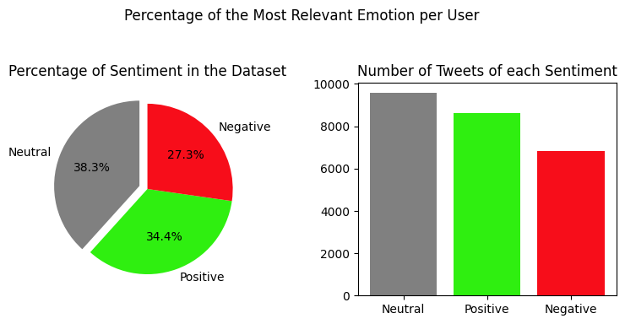
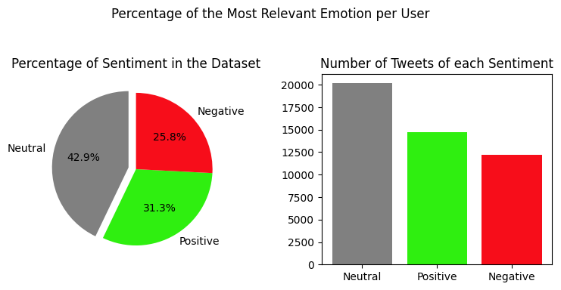
Let’s observe users’ emotions through the bar chart:

Slide 8
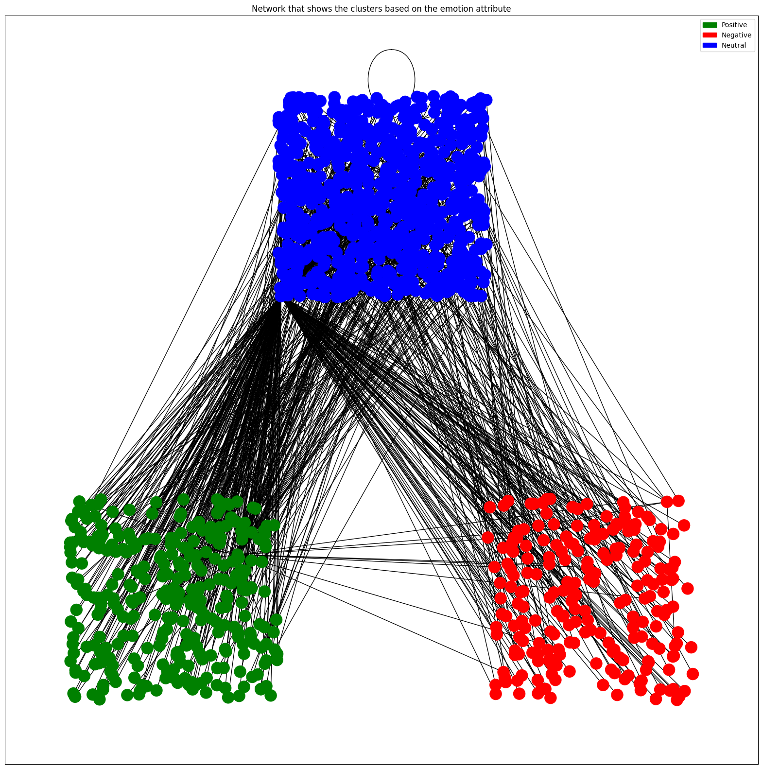
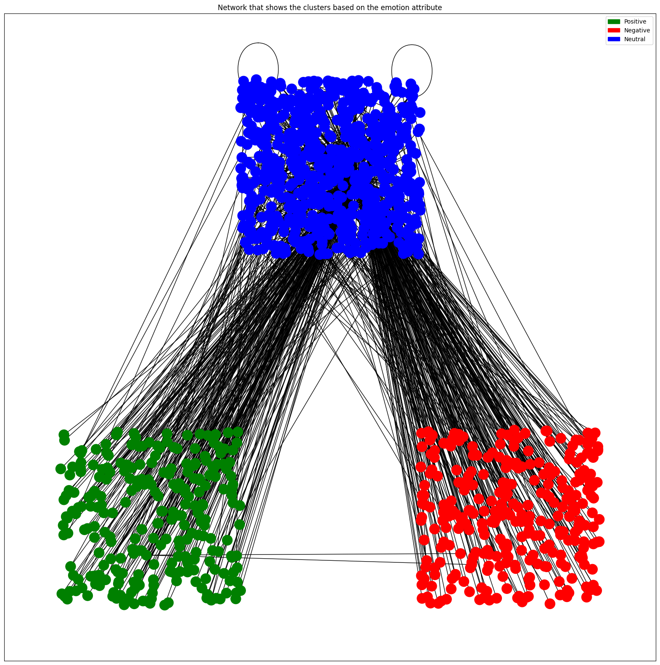
Data visualization with clusters

Slide 9
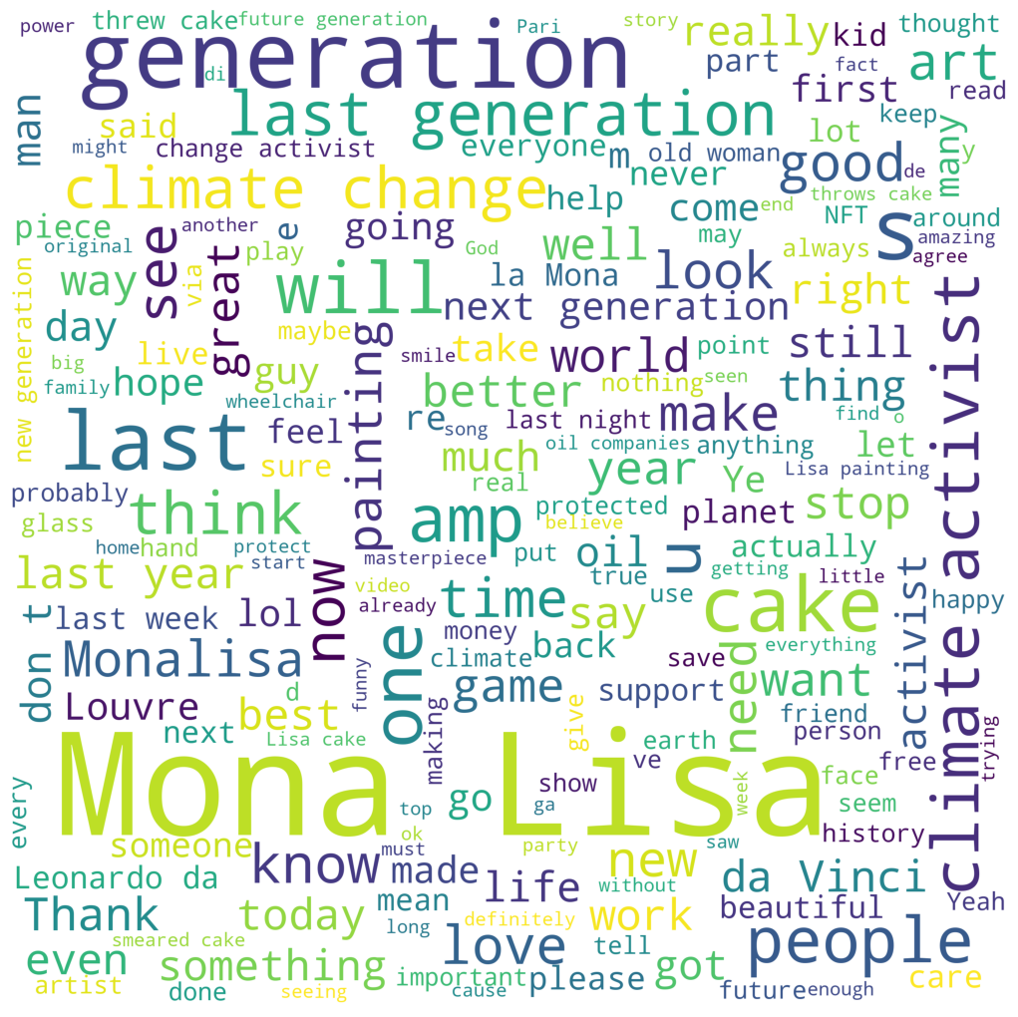
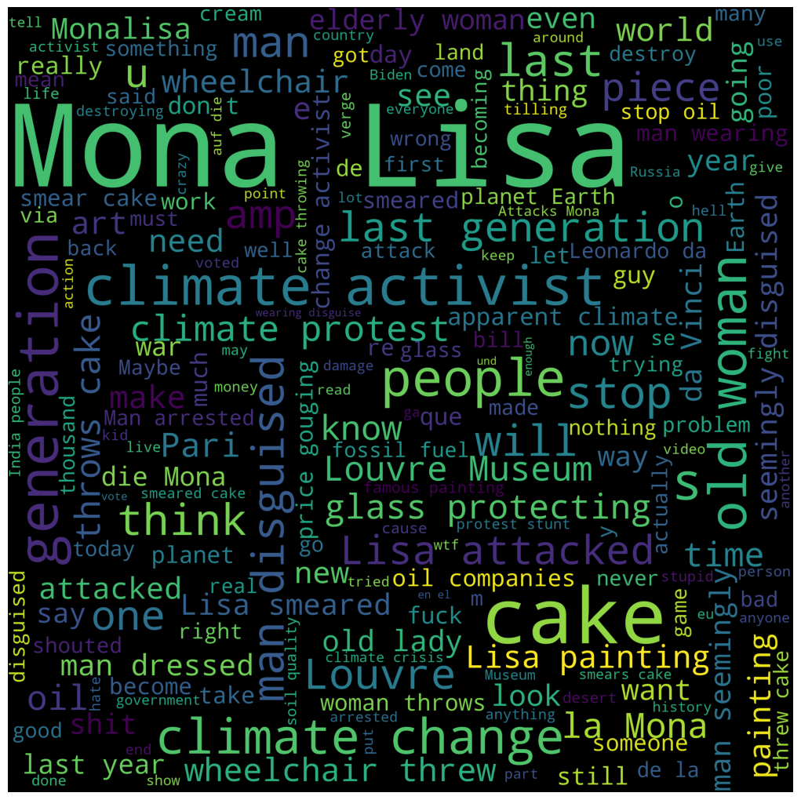
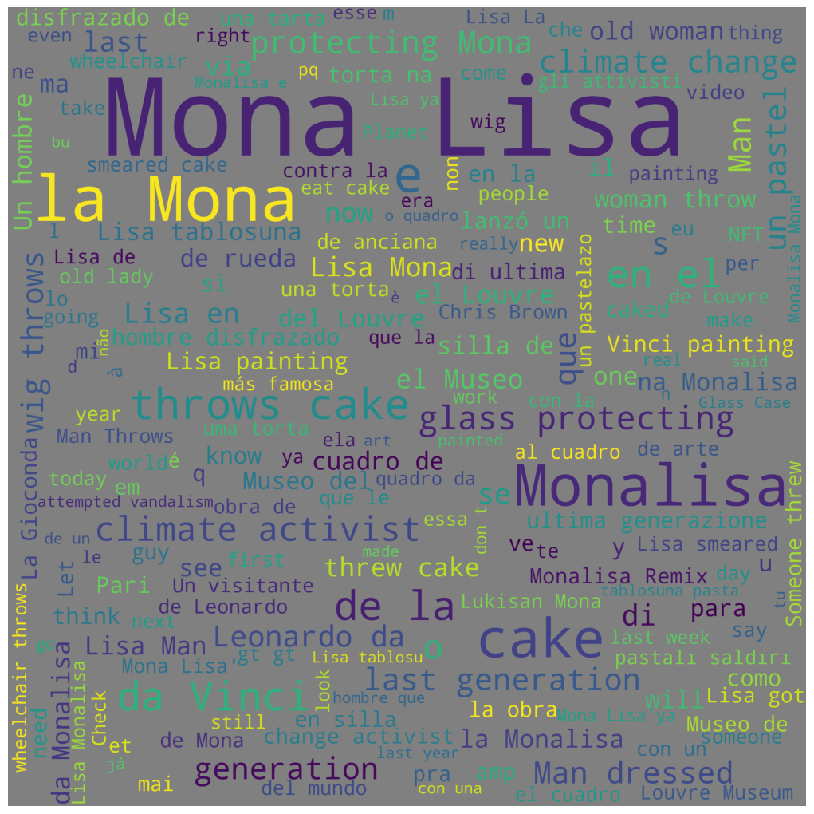
The Word Cloud obtained from raw texts with positive, negative, and neutral sentiment are as follows:
Positive WordCloud
Negative WordCloud
Neutral WordCloud

Slide 10
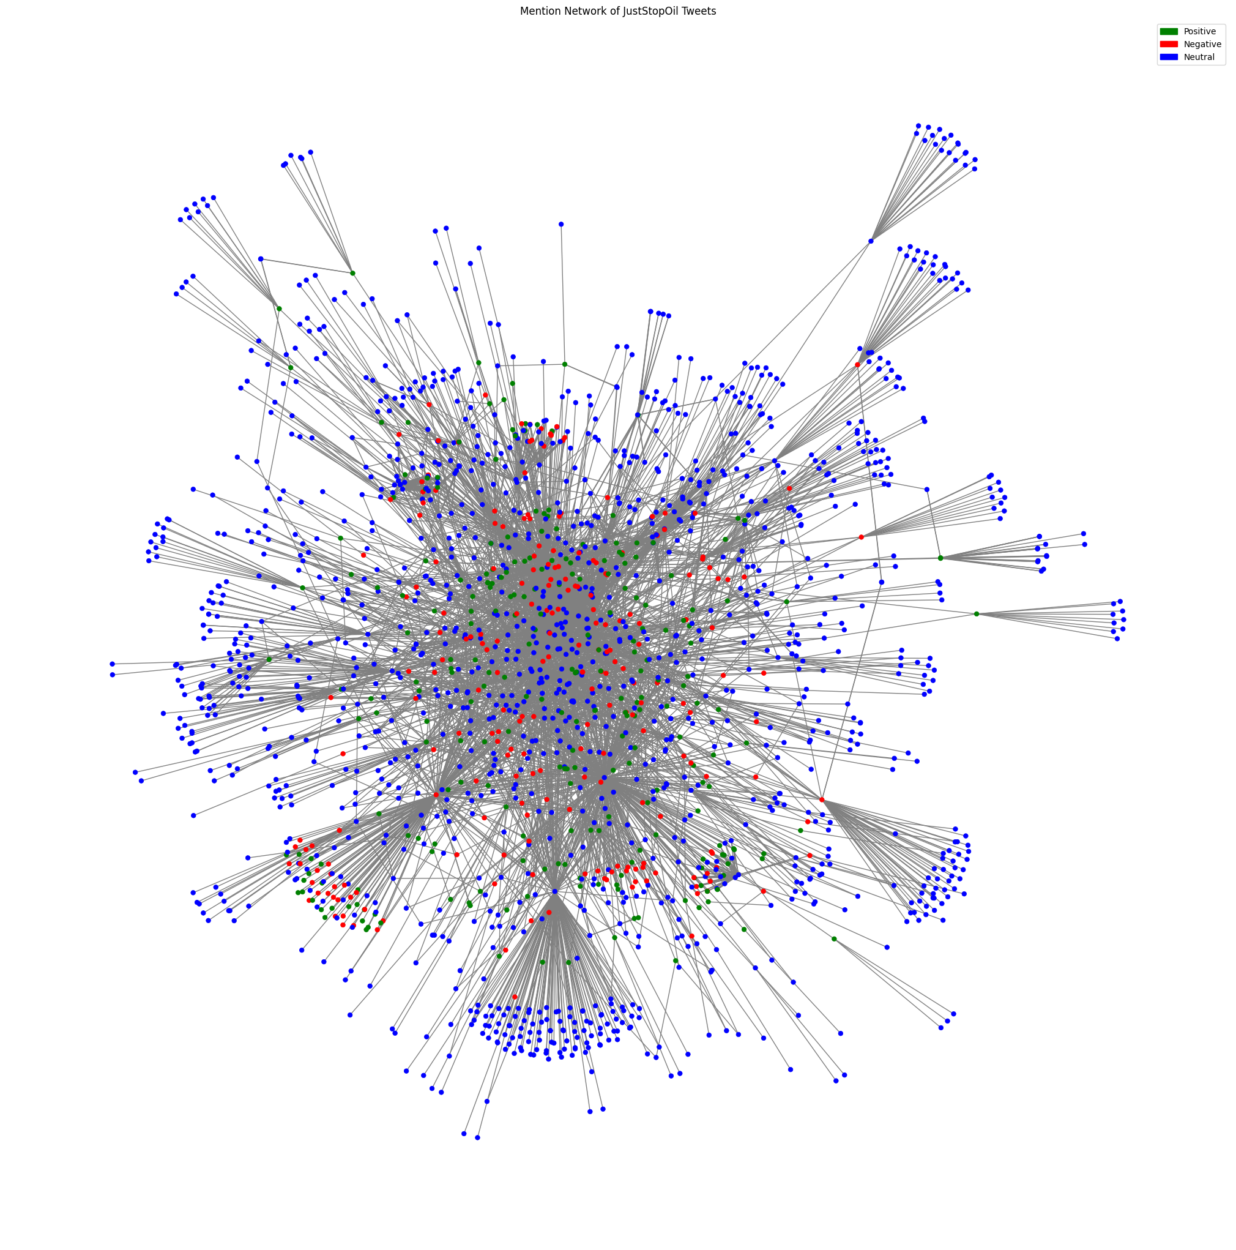
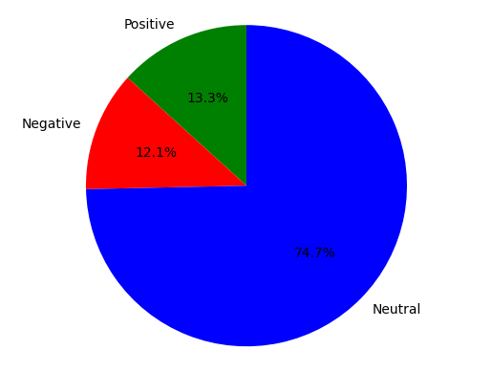
DATA ELABORATION
Below, the network and percentage of each emotion regarding the social movement to which the Protestants belong will be shown.

Slide 11
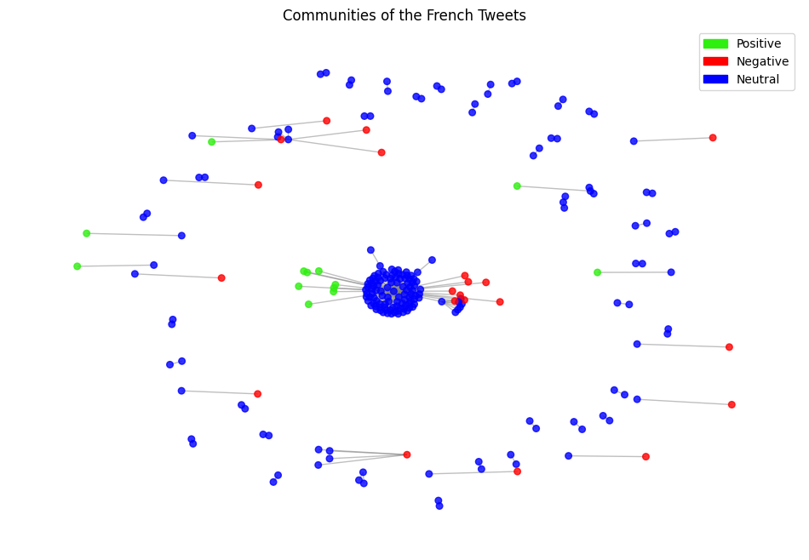
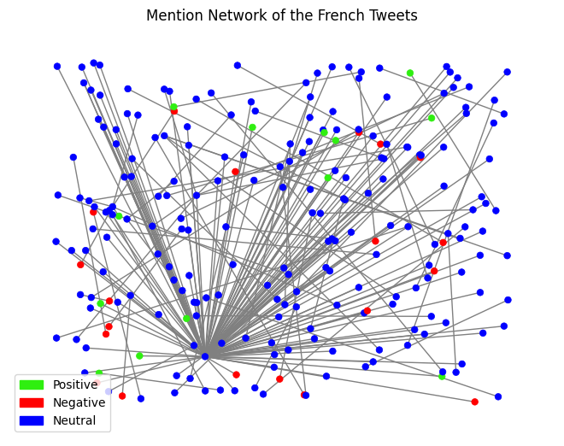
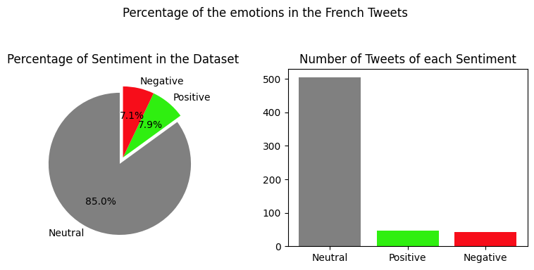
DATA ELABORATION
Targeted analysis of users belonging to the country where the event took place.

Slide 12
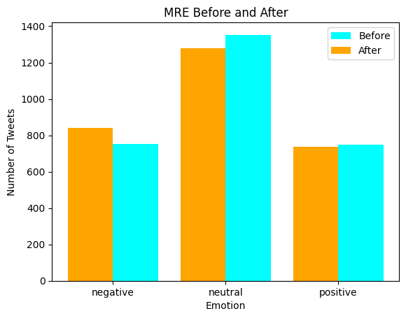
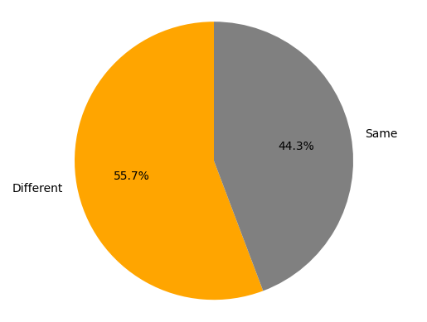
DATA ANALYSIS CONCLUSION
At the end of the data analysis, it was necessary to determine the percentage of users who changed their sentiment after the event.

Slide 13
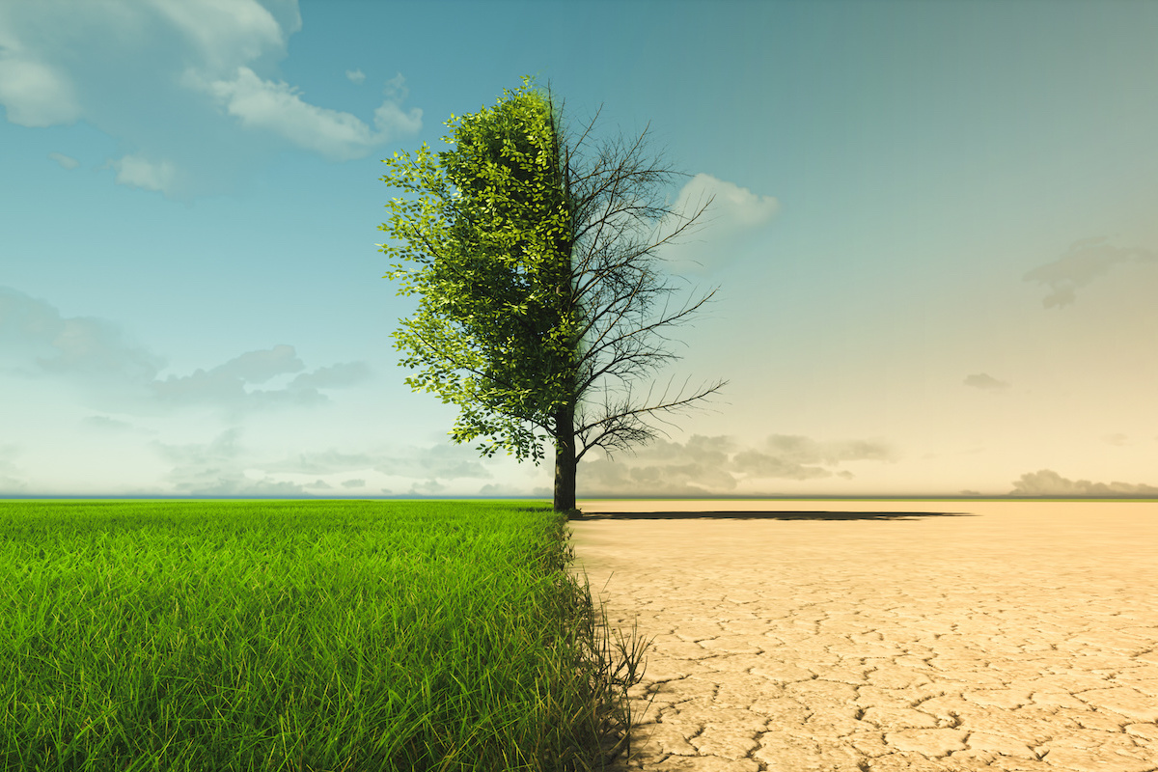
CONCLUSIONE
In summary, climate change was already recognized as an important issue, and acts of vandalism involving works of art cannot prevent it.
To achieve this goal, governments and companies need to be sensitized about their effects, leading to the implementation of climate policies and regulations, encouraging the use of renewable energy and investment in sustainable technologies.

